Slide 1
SQL Project (Superstore)
Written by:- Pratik Deore
batch:- Neowise

Slide 2
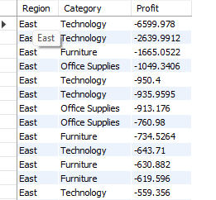
1.Which is the most loss making category in the East region
ANS:-
select Region , Category ,Profit from superstore where profit < 0 and Region= 'East' order by 3 asc;

Slide 3

2. Give me the top 3 product ids by most returns
ANS:-
select s.Product_ID ,COUNT(r.Returned) as re from superstore as s join returns as r on s.Order_ID = r.Order_ID group by 1 order by re desc limit 3;

Slide 4
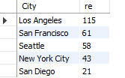
3.In which city the most number of returns are being recorded
ANS:-
select l.City ,COUNT(r.Returned) as re from location as ljoin superstore as s on s.Postal_Code = l.Postal_Code join returns as r on s.Order_ID = r.Order_ID group by 1 order by re desc limit 5;

Slide 5

4.Find the relationship between days between order date , ship date and profit
ANS:-
select Ship_Date, Order_Date, (Ship_Date - Order_Date) as diff , Profit from superstoregroup by diff order by diff asc limit 3;

Slide 6

5. Find the region wise profits for all the regions and give the output of the most profitable region
ANS:-
select Region , round(Sum(Profit),2) as p FROM superstore group by 1 order by 2 desc limit 1;

Slide 7
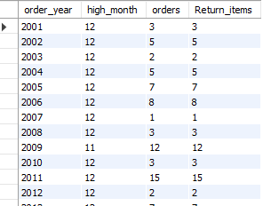
6.Which month observe the highest number of orders placed and return placed for each year
ANS:-
with cte as(select month(s.Order_Date) as order_month , Year(s.Order_Date) as order_year, count(*)as orders , count(r.Returned) as Return_items from superstore as s join returns as r on s.Order_ID = r.Order_ID group by 1,2)
select order_year, max(order_month) as high_month,orders, Return_items from cte group by 1 order by 1 ;

Slide 8
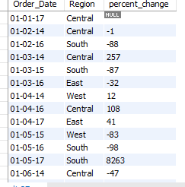
7.Calculate percentage change in sales for the entire dataset? X axis should be year_month Y axis percent change
ANS:-
WITH recursive cte AS ( SELECT Order_Date, Sales,Region, LAG(Sales) OVER (ORDER BY Order_Date) AS prev_sales FROM superstore)
SELECT Order_Date, Region, round( (Sales - prev_sales) / prev_sales * 100 )AS percent_changeFROM cte
group by 1 ;

Slide 9
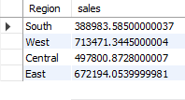
8.Find out if any sales pattern exists for all the region
ANS:-
select Region , Sum(Sales) as sales from superstore
group by 1;

Slide 10
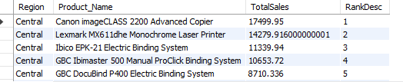
9.Top and bottom selling product for each region
WITH CTE AS (
SELECT Region, Product_Name, SUM(Sales) AS TotalSales FROM superstore GROUP BY Region, Product_Name)
SELECT Region,Product_Name, TotalSales, ROW_NUMBER() OVER (PARTITION BY Region ORDER BY TotalSales DESC) AS RankDesc FROM CTE;

Slide 11

10. Why are returns initiated? Are there any specific characteristics for all the returns? Hint: Find return across all categories to observe any pattern
ANS:-
select s.Category , count(r.Returned) from superstore as s join returns as r on s.Order_ID = r.Order_ID group by 1;

Slide 12
11. Create a table having two columns ( date and sales), Date should start with the min date of data and end at max date - in between we need all the dates If date is available show sales for that date else show date and NA as sale

